Slide 1
Final Project - Churn D desktop
File created on: 06/07/2024 10:32:16

Slide 2
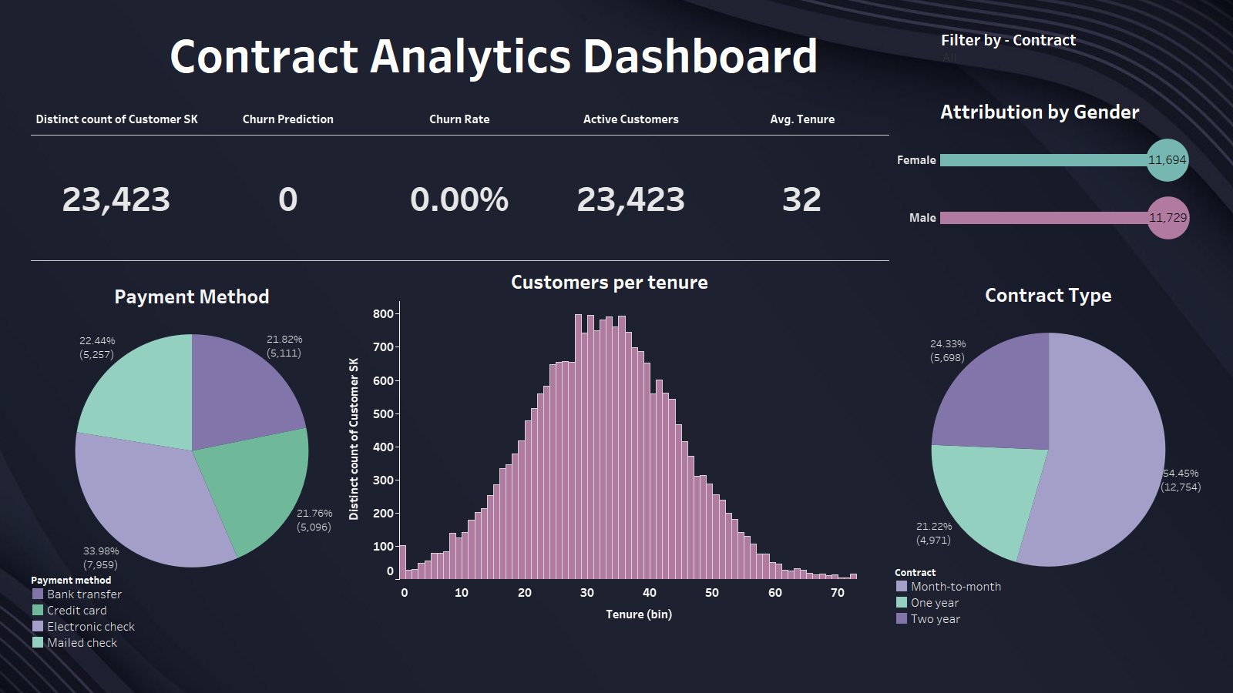

Slide 3
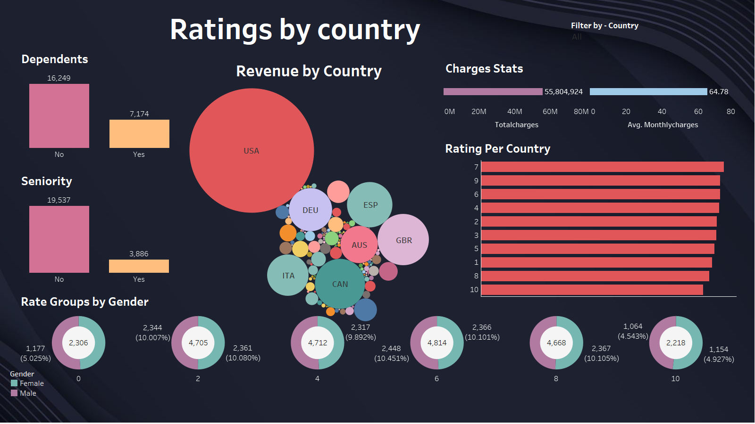

Slide 4
